Slide 1
Oracle Data Integrator
Components and Types of Transformations

Slide 2
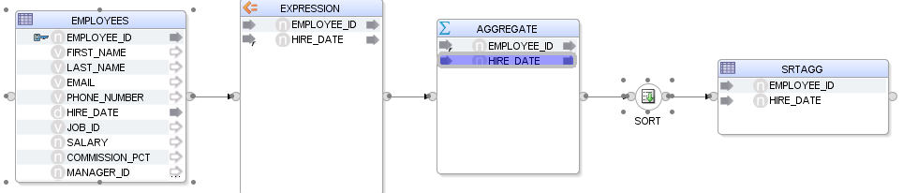
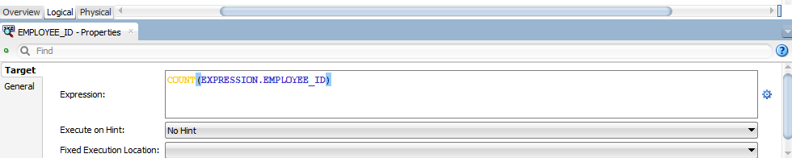
Aggregation Transformation:
Purpose: Aggregations are used to calculate summary statistics, such as sums, averages, counts, minimums, and maximums, on groups of data.
Usage: Aggregations are commonly applied when consolidating data or generating reports that require aggregated values.

Slide 3
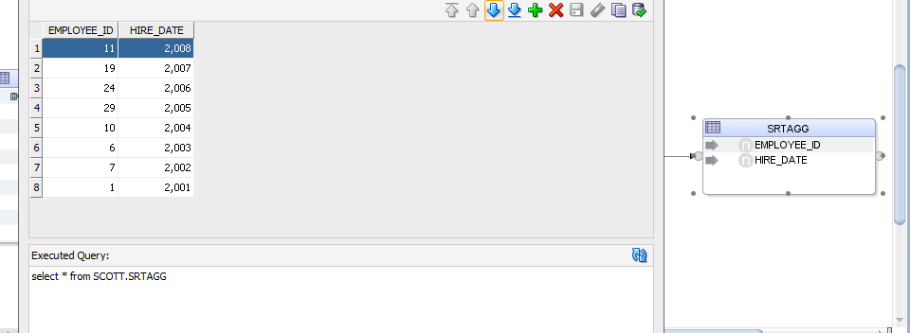
I have utilized an aggregate function, specifically 'count', to determine the total number of employees.

Slide 4
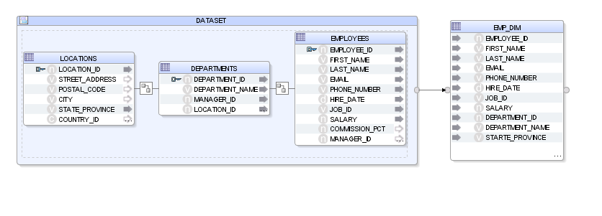
Data Set:
When configuring a transformation component (e.g., join, filter, lookup), you specify one or more input data sets from which the transformation will read data.
Input data sets can be tables from a database, flat files, or the output of previous transformation components in the data flow.
The transformation component processes the data within the input data sets according to the defined transformation logic.

Slide 5
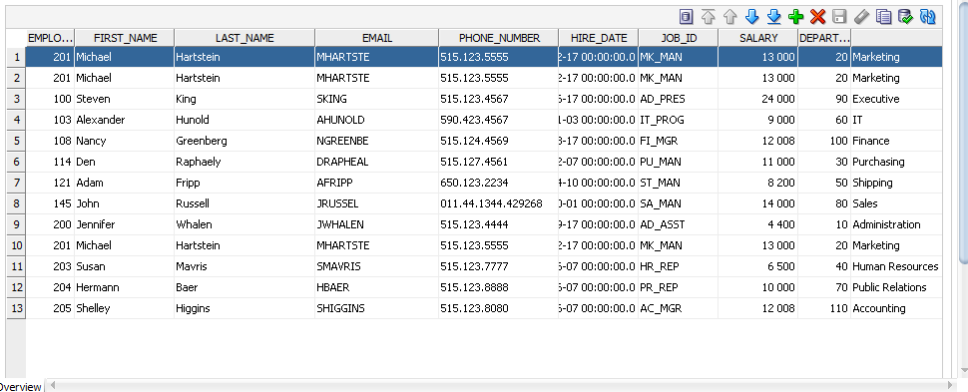
Data sets are joined using dataset transformation o create an employee dimension table.

Slide 6
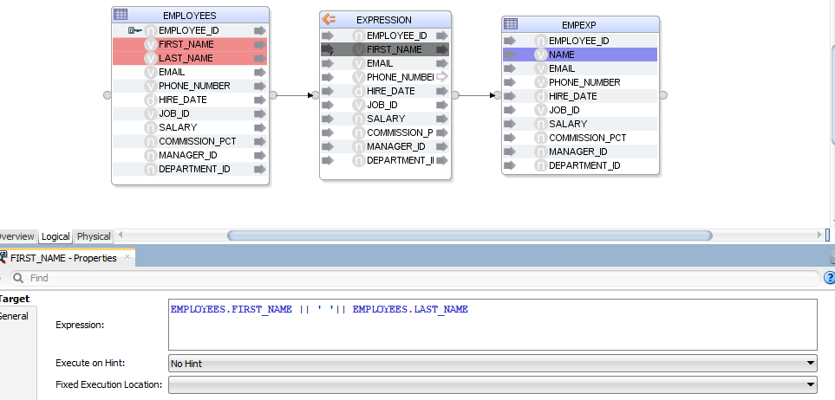
Expression Transformation:
Purpose: Expressions are used to perform calculations, manipulate values, and derive new data fields using mathematical operations, functions, and logical conditions.
Usage: Expressions are versatile and can be applied to transform data in various ways, such as concatenating strings, formatting dates, or performing conditional logic.

Slide 7
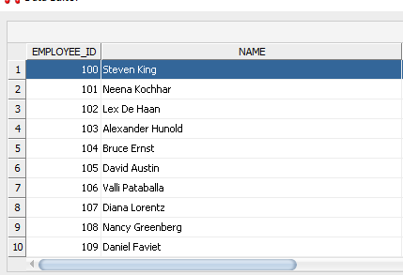

Slide 8
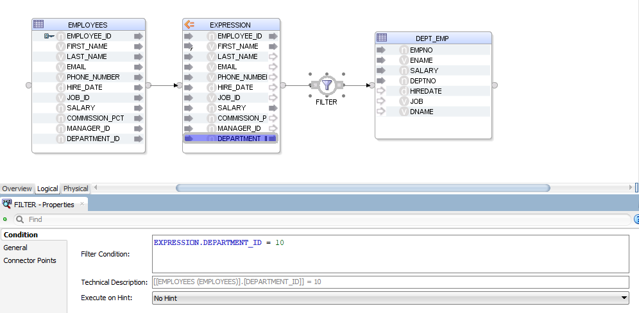
Filter Transformation:
Purpose: Filters are used to selectively include or exclude records from the data based on specified criteria.
Usage: Filters are employed to focus on specific subsets of data or to remove unwanted records before further processing.

Slide 9
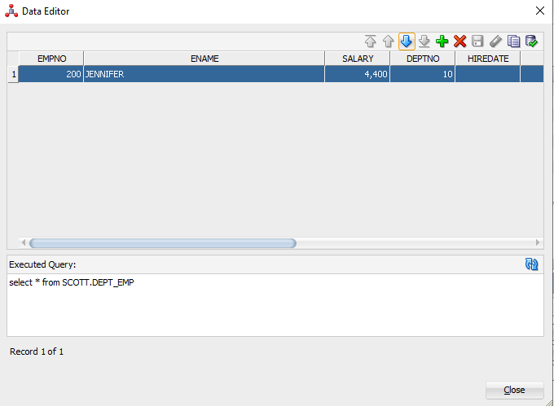
It selected department with 10.

Slide 10
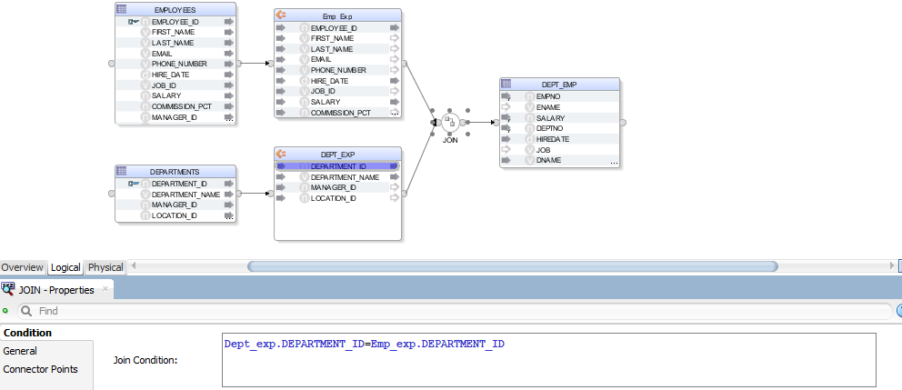
Join Transformation:
Purpose: Joins are used to combine data from multiple sources based on matching keys or conditions.
Usage: Joins are fundamental for integrating data from different tables, files, or databases that share common attributes.

Slide 11
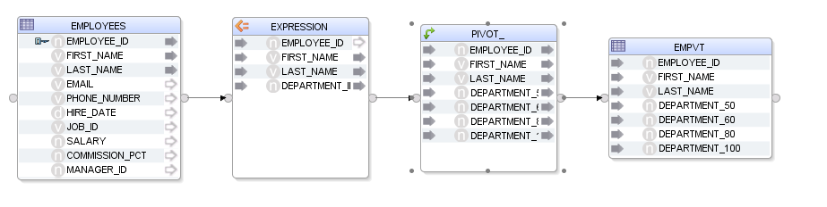
Pivot and Unpivot Transformation:
Purpose: Pivot and Unpivot transformations are used to rotate data from rows into columns (Pivot) or from columns into rows (Unpivot).
Usage: These transformations are handy for transforming data between wide and narrow formats or vice versa, facilitating analysis and reporting.

Slide 12
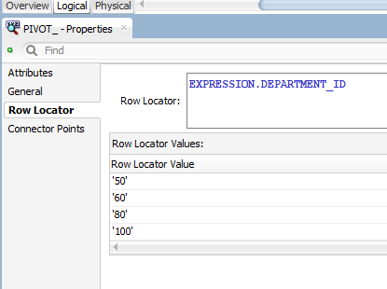
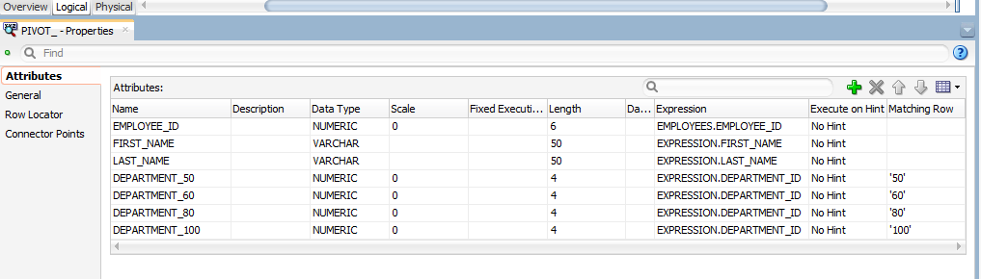
Create row locator variable for selecting in matching rows
Select the created row locators in matching rows below

Slide 13
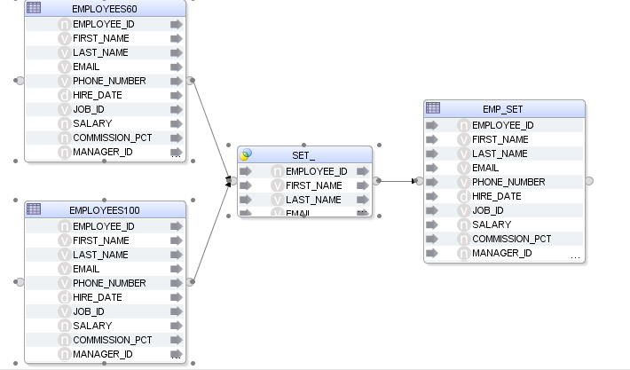
Set Operations:
Purpose: Set operations allow users to perform operations such as union, intersect, and minus between two or more datasets.
Usage: Set operations are useful for combining or comparing datasets to identify common records, differences, or to merge datasets without duplication.

Slide 14
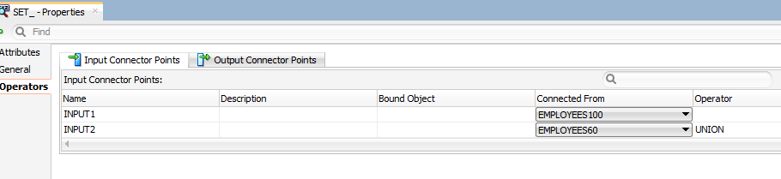
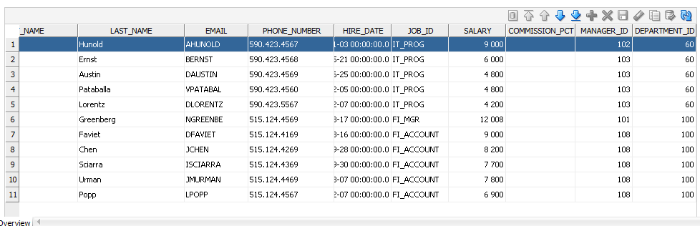

Slide 15
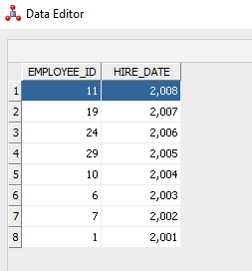
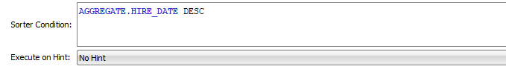
Sort Transformation:
Purpose: Sort transformations are used to order data based on specified criteria, such as ascending or descending order of values in one or more columns.
Usage: Sorting data is often necessary before performing certain operations, such as merging datasets or performing aggregate calculations.
The data is sorted by hire date descending

Slide 16
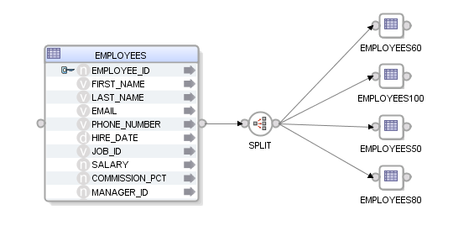
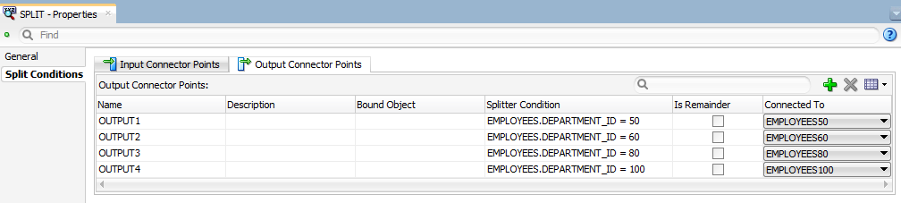
Split:
Purpose: The purpose of the Split transformation is to divide a dataset into smaller subsets or partitions based on specific conditions or criteria.
Usage: Split transformations are commonly used in scenarios where data needs to be partitioned for parallel processing, conditional routing, or distribution to different target systems or destinations.
The Department ids were splitted into 50,60,80 and
100.

Slide 17
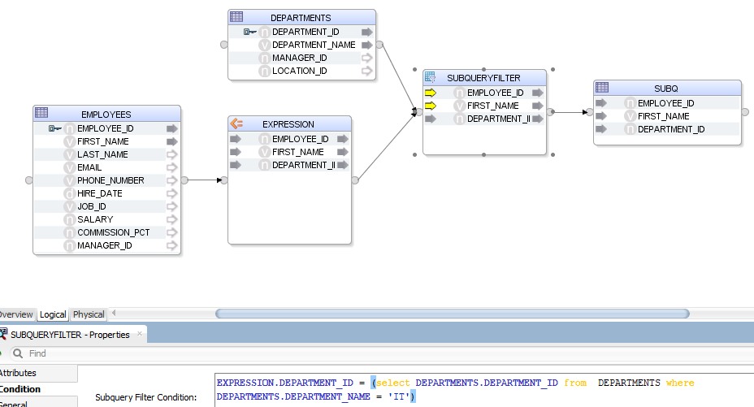
Subquery Filter:
Purpose: Subquery filters are used to filter data based on conditions that involve subqueries, allowing for more dynamic and complex filtering criteria.
Usage: Subquery filters are commonly used when the filtering criteria are based on values from another dataset, aggregate functions, or conditions that cannot be easily expressed using standard WHERE clause predicates.

Slide 18
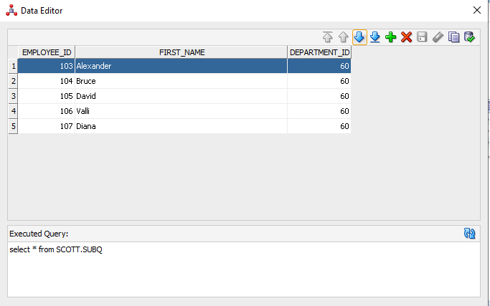
The department ids were filtered using subquery function

Slide 19
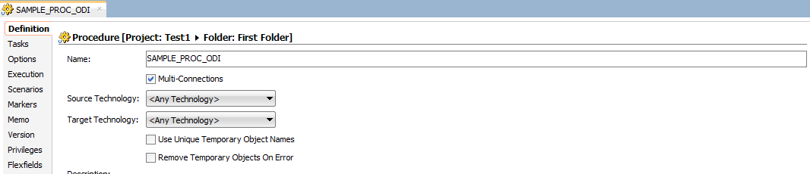
Procedure
Right-click on Procedures:
In the Projects Navigator, expand the folder for your project, and then locate the "Procedures" node.
Right-click on the "Procedures" node to open the context menu.

Slide 20
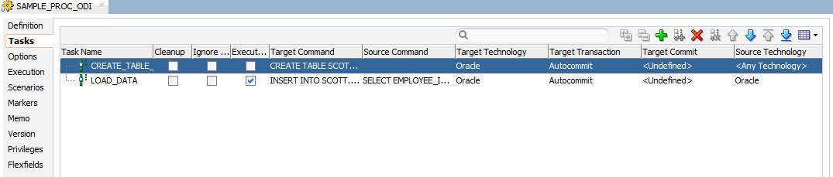
Select New Procedure:
From the context menu, select "New Procedure." This will open the "Create New Procedure" dialog box.
Enter Procedure Details:
In the "Create New Procedure" dialog box, you'll need to enter details about the new procedure:
Name: Provide a name for your procedure.
Folder: Select the folder where you want to save the procedure within your project.
Technology: Choose the appropriate technology for your procedure. This could be "SQL" for a SQL-based procedure, "Java" for a Java-based procedure, or "Generic" for a generic procedure that doesn't require specific technology.
Language: If applicable, select the programming language for your procedure (e.g., SQL or Java).

Slide 21
Design the Procedure:
Once you've provided the necessary details, click "OK" to create the procedure. This will open the procedure editor where you can design the logic for your procedure.
Depending on the technology and language chosen, you'll use the appropriate editor to define the procedure's code or logic.
Write Procedure Logic:
Write the code or logic for your procedure in the editor. For SQL procedures, you'll typically write SQL statements. For Java procedures, you'll write Java code.
Use the available features in the editor, such as syntax highlighting, code completion, and error checking, to help you write the procedure logic accurately.
Save the Procedure:
After you've finished designing the procedure, save your changes by clicking the "Save" button in the toolbar or by selecting "Save" from the File menu.
Validate the Procedure (Optional):
You can validate the procedure to check for any errors or issues. Right-click on the procedure in the Projects Navigator and select "Validate" from the context menu.

Slide 22
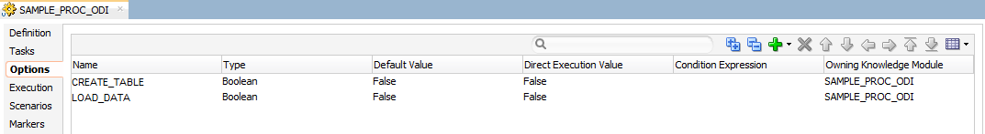

Slide 23
Reusable Mappings:
1)Modularity:
Reusable mappings promote modular design by allowing you to encapsulate specific data integration logic or transformations into separate mapping objects.
This modular approach enhances reusability and maintainability, as the same mapping logic can be easily reused across multiple data integration processes.
2)Consistency:
By centralizing common data transformation logic within reusable mappings, you ensure consistency in data processing across different integration projects or scenarios.
Any updates or enhancements made to a reusable mapping are automatically reflected wherever it is used, eliminating the need for redundant modifications.
3)Efficiency:
Reusable mappings help streamline development efforts by reducing duplication of effort and promoting a "build once, reuse many times" approach.
Developers can leverage pre-existing mapping components to accelerate the development of new data integration solutions, leading to increased efficiency and productivity.

Slide 24
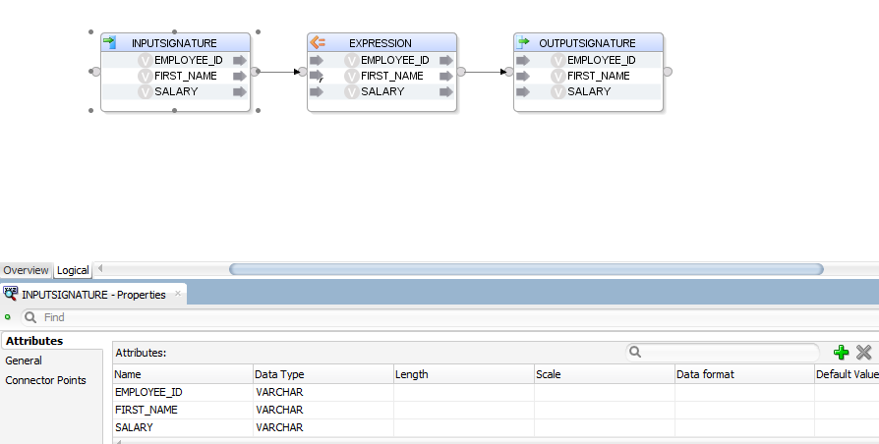
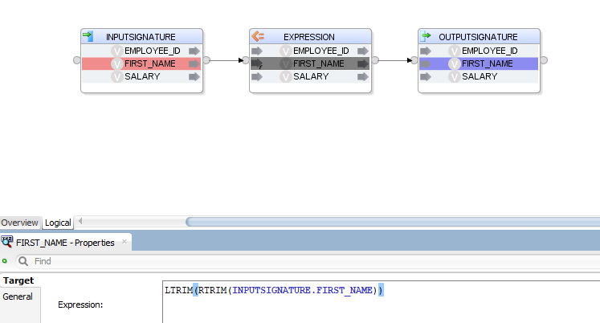
1.Click the plus mark to create attributes
2.Rename the attributes
1.Select the attributes and give the expressions

Slide 25
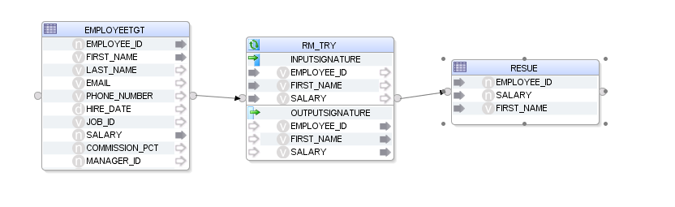
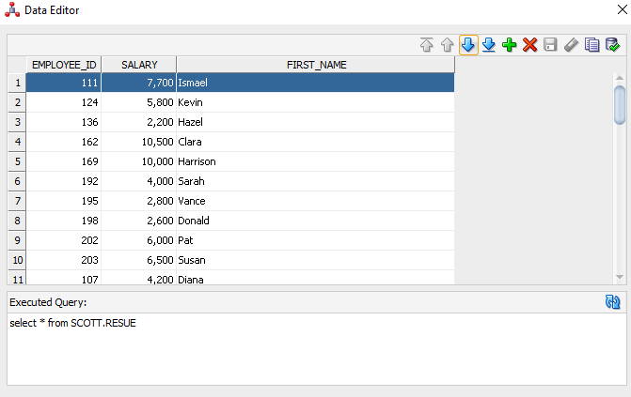
1.Create a new mapping and drag the source table
2.Drag the reusable mapping and map the columns
3.Drag the column able into the mapping section and map the reusable mapping and target mapping

